Slide 1

Build cross platform application using Flutter
Sarankumar N
@sarankumar_ns

Slide 2



What’s Programming?
Set of Instruction
Process operation
Get Result

Slide 3


Slide 4

Integrated Development Environment
Software Development Kit

Slide 5

IDE
android
studio

Slide 6

SDK

Slide 7
Setup
Android Studio - developer.android.com/studio
Flutter - flutter.dev/docs/get-started/install/windows

Slide 8

Widgets All Along
Text
Icon
Image
Row
Column
Container

Slide 9
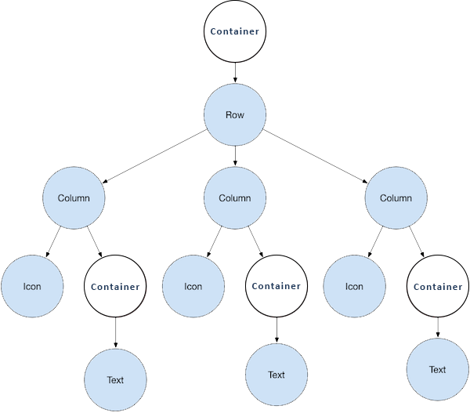

In Action ->

Slide 10

Let’s Start

Slide 11

Packages

Slide 12

Q & A

Slide 13
Resources
bit.ly/flutter_webinar

